Slide 1

Why did Britain govern Palestine-Israel between 1920 and 1948?
Lesson 4

Slide 2
Learning objectives
By the end of this lesson, you should be able to:
Define Mandate Palestine
Explain why Britain governed Palestine-Israel between 1920 and 1948
Compare Britain’s promises to Palestinians and Jews at this time

Slide 3
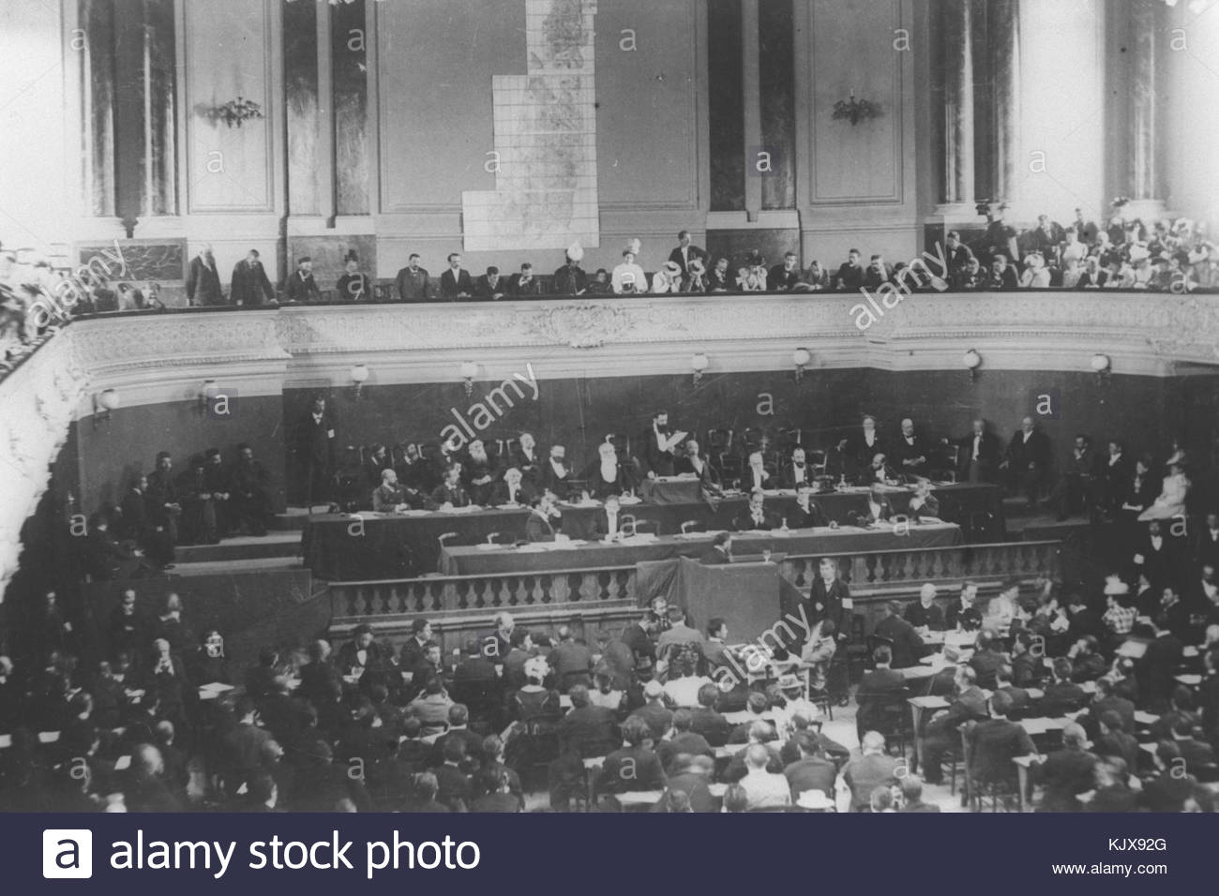
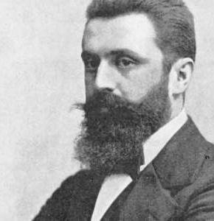
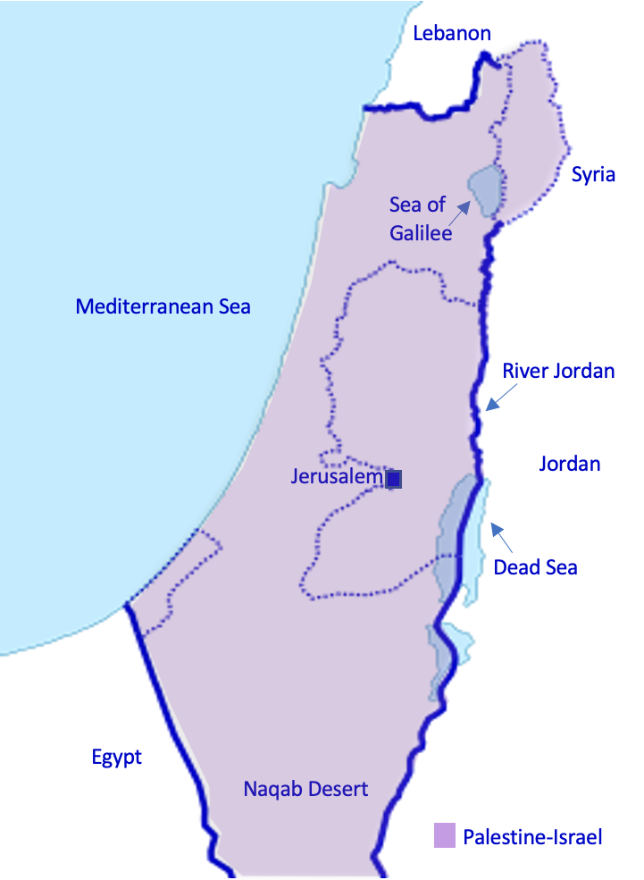
Recap
What is Zionism? What did 19C and early 20C Zionists want?
What did Palestinian nationalists want at this time?
Zionism is the Jewish national movement to establish a Jewish state between the Mediterranean Sea and the River Jordan (in Palestine-Israel)
Palestinian nationalism emerged at the turn of the twentieth century. It is the movement to establish a Palestinian state between the Mediterranean Sea and the River Jordan (in Palestine-Israel)

Slide 4
4a. Keywords
When a country or nation forms its own government and determines its own future, rather than being ruled by a foreign power
Mandate
An international organisation set up after WWI to avoid another world war
British Empire
Territories under British control between the 1500s and 1900s
Self-determination
Legal authority granted by the League of Nations to temporarily govern a territory that used to be part of the Ottoman or German empire
League of Nations
Cut out and match these keywords with their definitions

Slide 5
4a. Keywords
Legal authority granted by the League of Nations to temporarily govern a territory that used to be part of the Ottoman or German empire
Mandate
Territories under British control between the 1500s and 1900s
British Empire
When a country or nation forms its own government and determines its own future, rather than being ruled by a foreign power
Self-determination
League of Nations
An international organisation set up after WWI to avoid another world war
Cut out and match these keywords with their definitions
Now stick them into your glossary

Slide 6

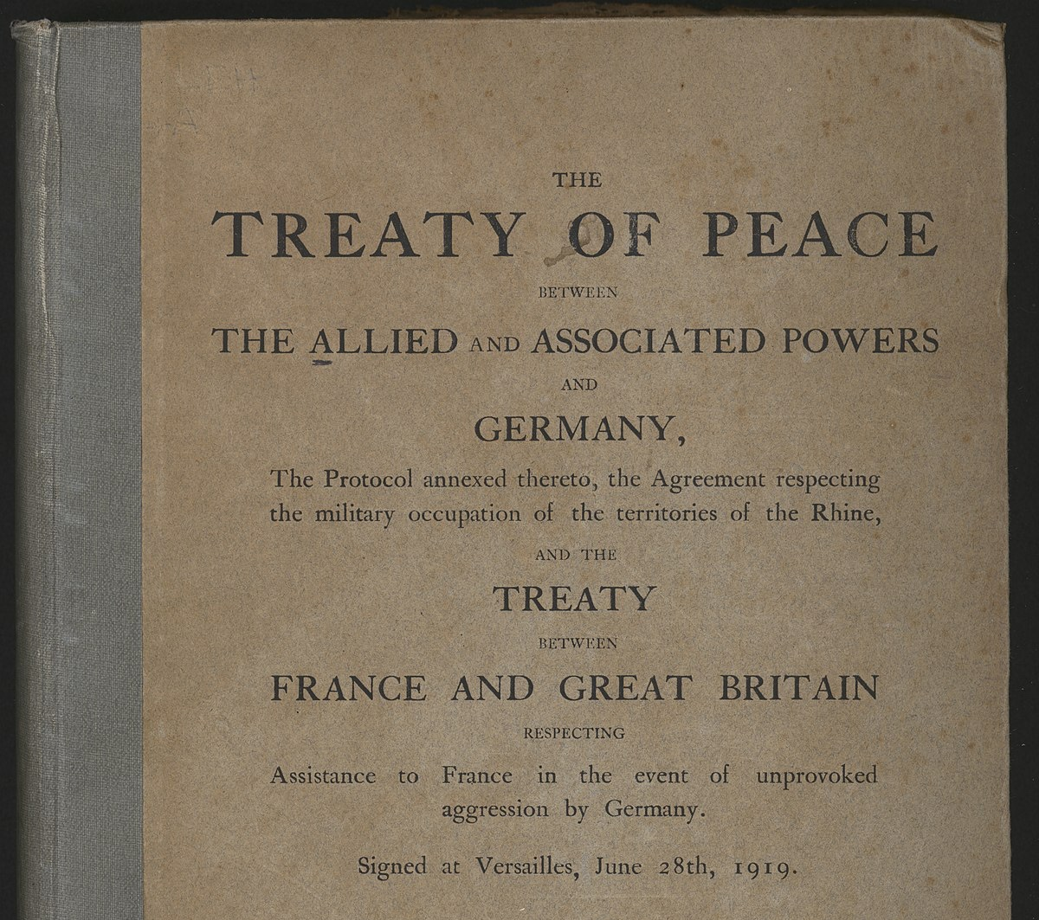
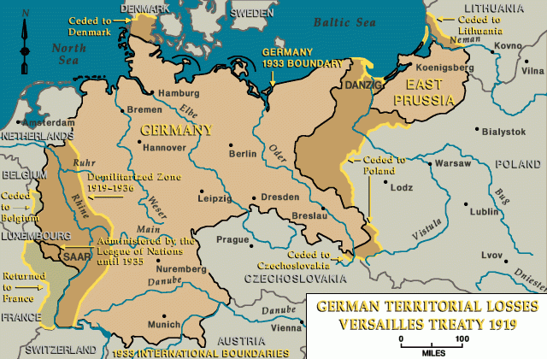
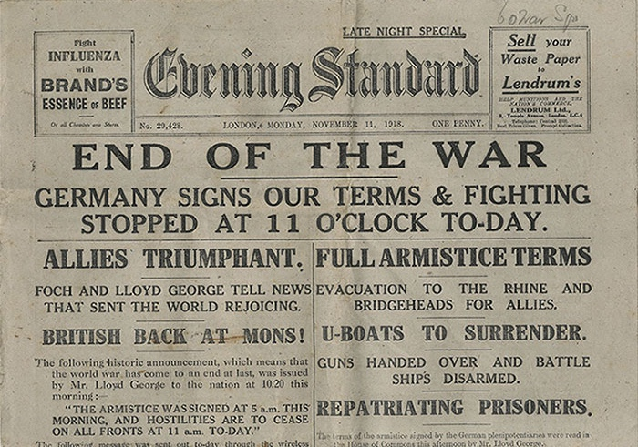


Starter activity
WWI ended on 11th November 1918, when Germany surrendered and all nations had agreed to stop fighting. On 28th June 1919, the Treaty of Versailles formally ended the war. This was negotiated at the Paris Peace Conference and it was signed by Germany, Britain, France, Italy and Russia
What do you know about the Treaty of Versailles?
What were the consequences for Germany?

Slide 7

The Treaty of Versailles’ consequences for Germany
Germany had to accept full responsibility for the war under Clause 231: the ‘War Guilt Clause’
Territorial losses:
  In Europe: Germany lost 13% of its European territory
  Outside Europe: Germany lost all its colonies
  Overall: Germany lost approx. 7 million people
Reparations: 132 billion gold marks = $269 billion today
Military restrictions: the Rhineland became a demilitarised zone (no German military was allowed there) and the German military was limited to 100,000 soldiers and 15,000 sailors

Slide 8

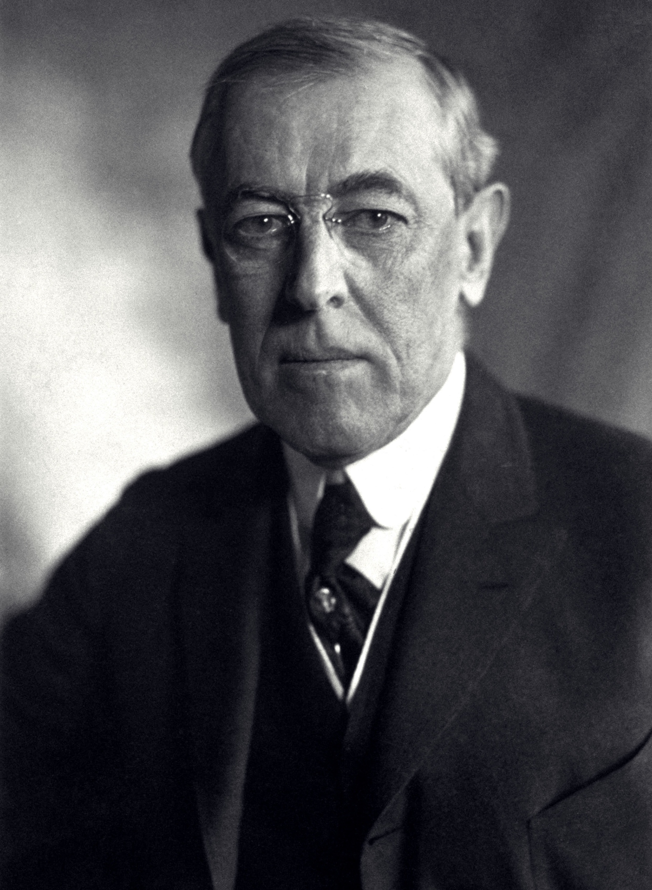
The League of Nations
The establishment of the League of Nations was another important consequence of WWI. Have you come across the League of Nations before? What can you remember about this organisation?
The League of Nations was an international organisation set up with the primary aim of avoiding another world war
The idea was that countries would settle disputes by negotiating, and they would also commit to disarmament (reducing their weapons)
One of the key individuals behind this was US President Woodrow Wilson. Wilson believed in self-determination

Slide 9
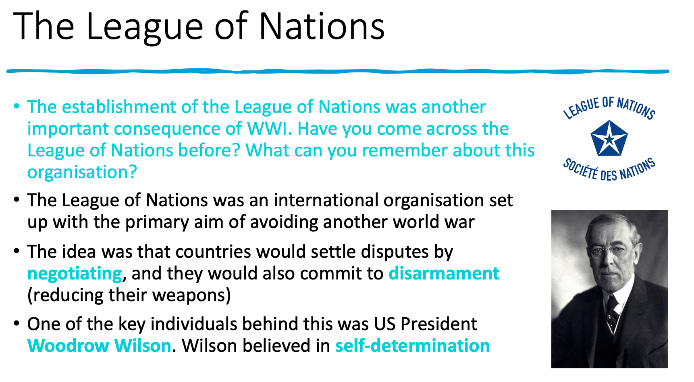
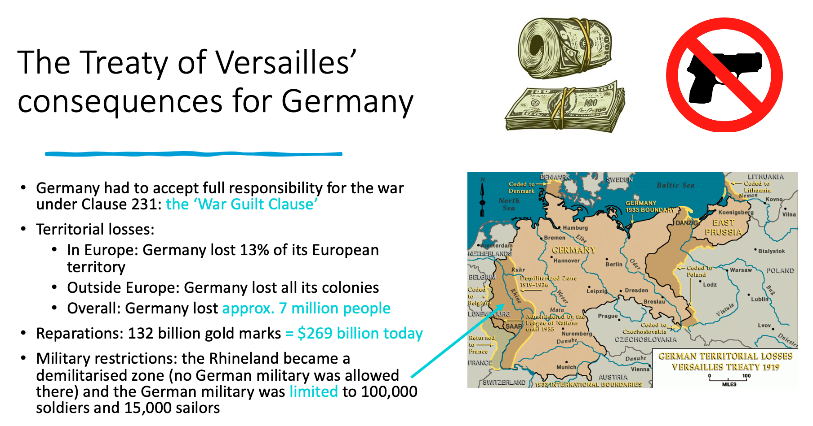
But what did this mean for Palestine-Israel?
Before WWI, Palestine-Israel was part of the Ottoman Empire
The Ottoman Empire had joined the war on the side of the Central powers including Germany in October 1914
When the Central powers were defeated, who was going to govern the territories of the former Ottoman Empire?
The League of Nations discussed this and came up with the idea of the Mandates system

Slide 10
The Mandates system
This was the idea that the territories of the former German and Ottoman empires, including Palestine-Israel, would be governed by the victorious powers of WWI until the League of Nations deemed that they were ready to govern themselves
The territories of the former German and Ottoman empires were divided into three groups:
  Class A Mandates (their independence was recognised but they would still be under British or French control): Iraq, Syria, Lebanon, Palestine-Israel
  Class B Mandates (the Allies were directly responsible for the administration of these territories): Tanganyika, parts of Togoland and the Cameroons, Ruanda-Urundi
  Class C Mandates (to be administered as part of Allied territory): South West Africa, New Guinea, Western Samoa, the islands north of the Equator in the western Pacific, Nauru
Mandates were meant to be fairer than colonies because the governing power was responsible to the League of Nations, and ultimately the aim was for the territory to achieve self-determination so govern itself. In reality, however, Mandates were still quite colonial in nature, as we’ll see in the example of Palestine-Israel…
Mandate
Legal authority granted by the League of Nations to temporarily govern a territory that used to be part of the Ottoman or German empire

Slide 11
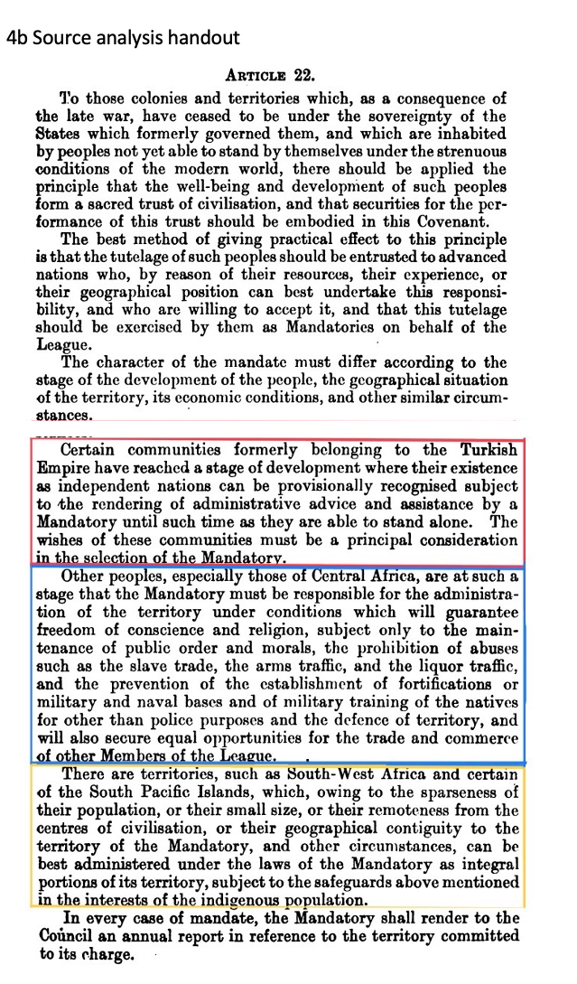
This is Article 22 of the Covenant of the League of Nations
Using handout 4b, read through the source in small groups
What do you think are the most important parts of this document? Why?
Class A (their independence was recognised but they would still be under British or French control): Iraq, Syria, Lebanon, Palestine-Israel
Class B (the Allies were directly responsible for administration of these countries): Tanganyika, parts of Togoland and the Cameroons, and Ruanda-Urundi
Class C (to be administered as part of Allied territory): South West Africa, New Guinea, Western Samoa, the islands north of the Equator in the western Pacific, and Nauru

Slide 12
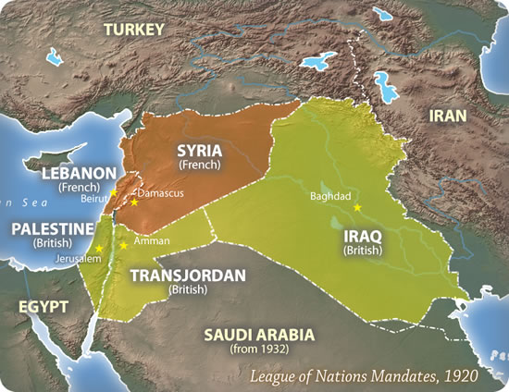
The Middle East Mandates
Why do we still use the term Middle East when referring to this part of the world? This term dates back to the outlook of the British Empire. An increasingly used alternative is Western Asia
As we have seen, the former territories of the Ottoman Empire (Syria, Lebanon, Iraq and Palestine-Israel) were deemed Class A Mandates. This meant that their independence was recognised but they were still to be under British or French control
Using the map to help you, which of the following Mandates was allocated to Britain?
  Syria
  Lebanon
  Iraq
  Palestine-Israel

Slide 13
The Middle East Mandates
Why do we still use the term Middle East when referring to this part of the world? This term dates back to the outlook of the British Empire. An increasingly used alternative is Western Asia
The former Ottoman Empire became:
  Mandatory Syria → allocated to France
  Mandatory Lebanon → allocated to France
  Mandatory Iraq → allocated to Great Britain
  Mandatory Palestine → allocated to Great Britain
  Mandatory Transjordan was also made a British Mandate in 1922
Britain was assigned the Mandate for Palestine-Israel in April 1920, established a civil administration in the country in July 1920, and the Mandate was legally approved in September 1923
Britain’s governance of Palestine lasted until 1948

Slide 14
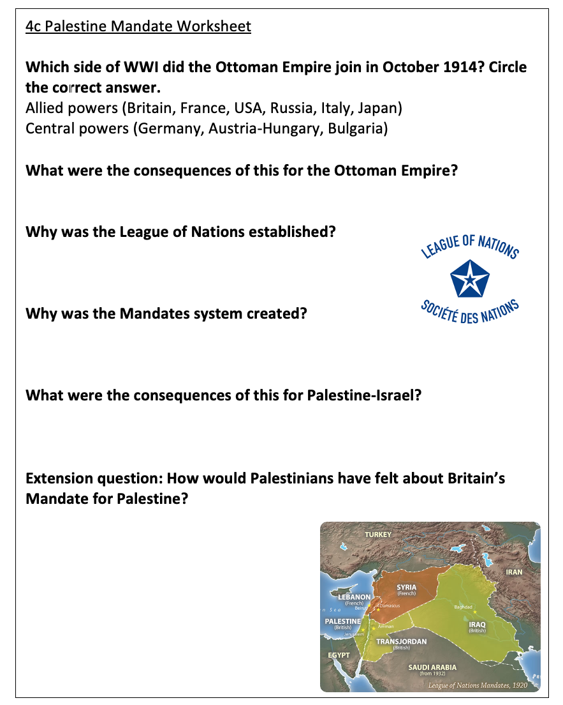
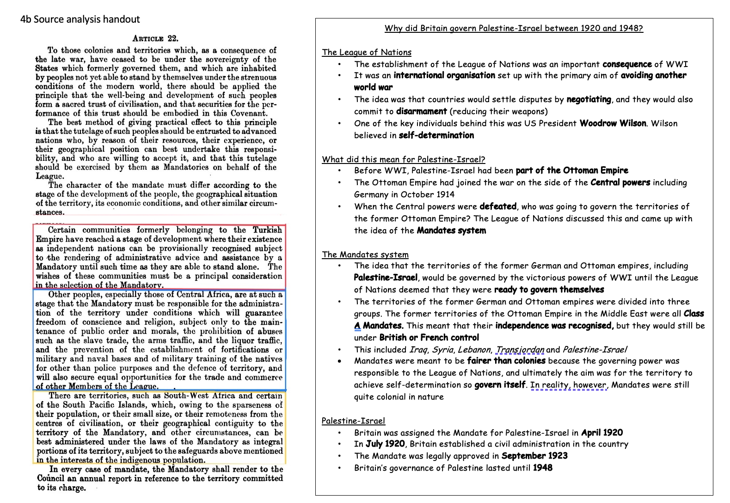
Worksheet 4c
Working individually, answer the questions using Handout 4b

Slide 15
The Ottoman Empire was defeated in WWI, so there was no one to govern its former territories
To prevent another world war by creating a space for countries to settle their disputes through discussion before resorting to violence. The members of the League would also commit to disarmament
Because the League believed that the populations of the former Ottoman and German empires were not yet ready to govern themselves. The idea was that they would be governed by the victorious powers until they were deemed ready to “stand by themselves”
Palestine-Israel became a Class A Mandate, meaning that its independence was recognised, but it would still be under European control. The Mandate for Palestine was granted to Britain in April 1920

Slide 16
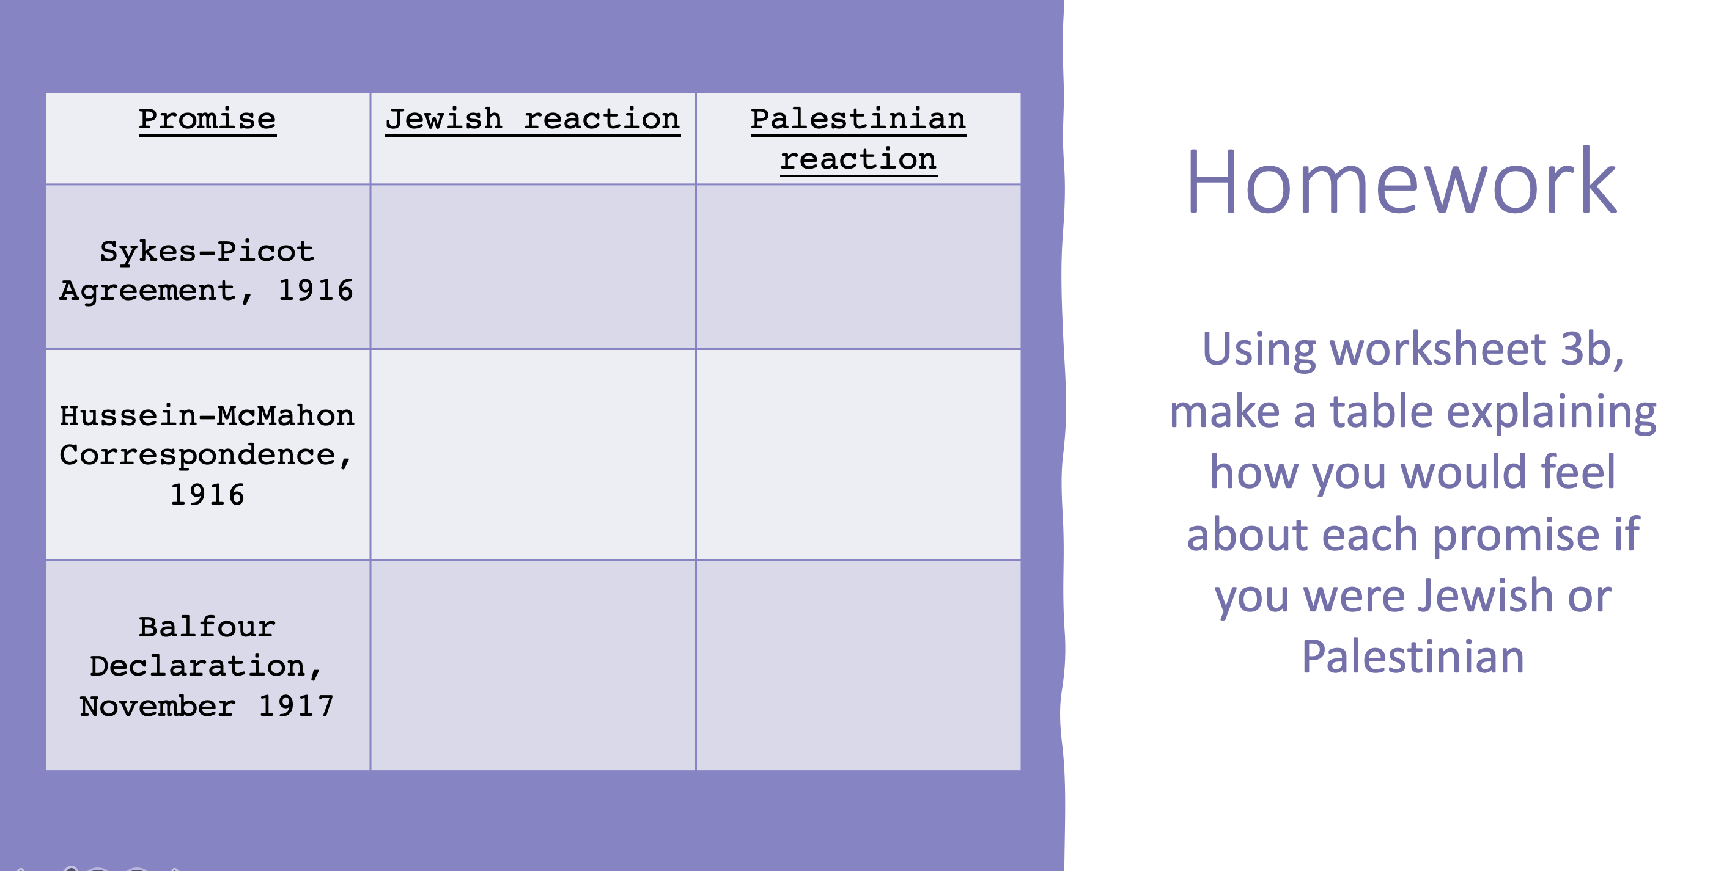
…but what had Britain already promised?
You are now going to be put into small groups. Each group will be allocated a promise:
  Group A: Sykes-Picot Agreement
  Group B: Hussein-McMahon Correspondence
  Group C: Balfour Declaration
Using your notes from last lesson together with your homework, prepare to give a 60 seconds summary of your promise to the rest of the class. You should answer these questions:
What was promised?
How did Palestinians feel about this?
How did Jews feel about this?

Slide 17
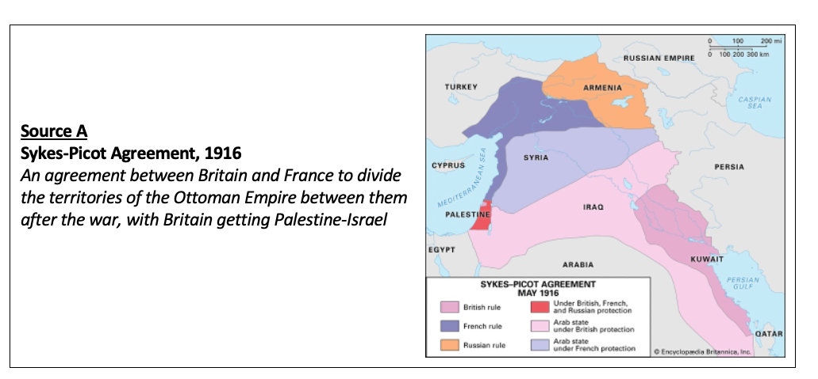
…but what had Britain already promised?
Sykes-Picot Agreement
An agreement between Britain and France to divide the territories of the Ottoman Empire between them after the war, with Britain getting Palestine-Israel

Slide 18
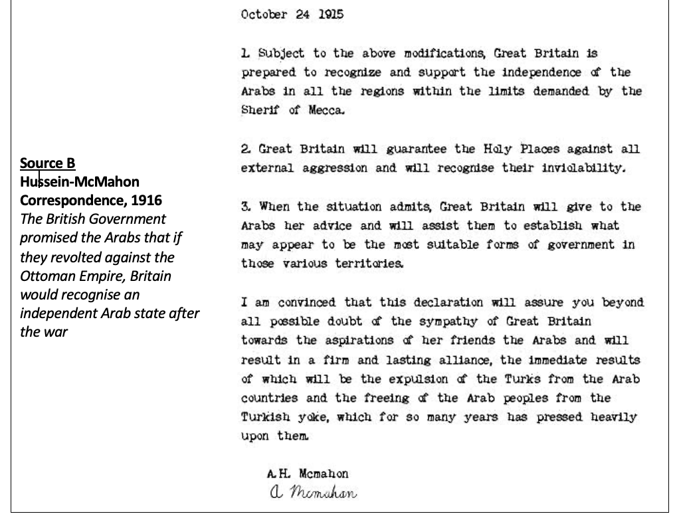
…but what had Britain already promised?
Hussein-McMahon Correspondence
The British Government promised the Arabs that if they revolted against the Ottoman Empire, Britain would recognise an independent Arab state after the war

Slide 19
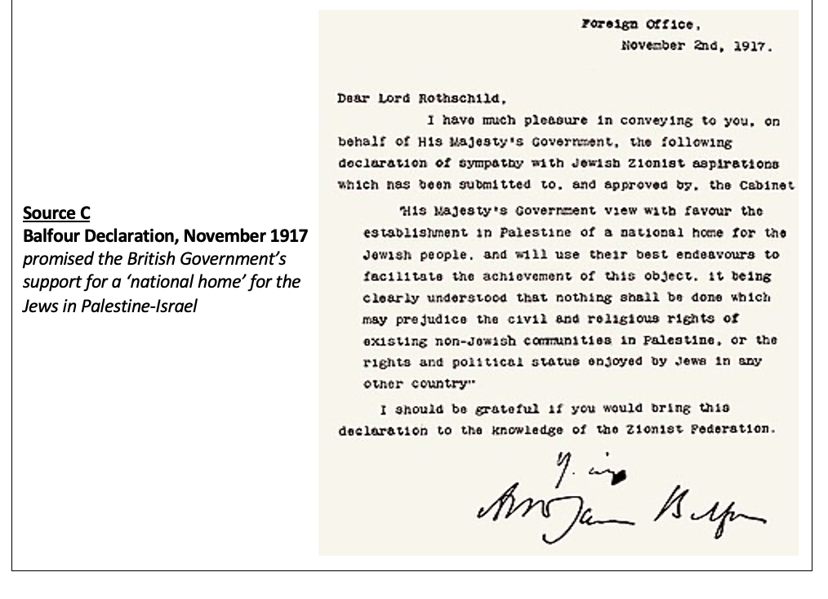
…but what had Britain already promised?
Balfour Declaration
Promised the British Government’s support for a ‘national home’ for the Jews in Palestine-Israel

Slide 20
Activity: What should Britain do?
Under the Hussein-McMahon Correspondence, Britain had promised to recognise Arab independence after the war
Under the Balfour Declaration, Britain had promised to support a ‘national home’ for the Jews in Palestine-Israel
Under the British Mandate for Palestine, Britain had promised the rest of the League of Nations to govern Palestine until Palestine was ready to ‘stand alone’
Factors to consider:
    The long history of antisemitism in Europe. Should the Jews now have their own state?
    Jews were expelled from Palestine-Israel 2000 years ago. Do they have a right to return?
    Palestine-Israel is now home to Palestinians. Should they be able to keep their land?
Use these terms in your discussions:
    Palestinian nationalism: the movement to establish a Palestinian state in Palestine-Israel
    Zionism: the Jewish national movement to establish a Jewish state in Palestine-Israel
In small groups, imagine you are advising the British government in the 1920s. Can you think of a way for Britain to meet its promises to both Palestinians and Jews?

Slide 21
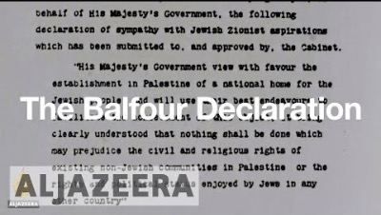
The text of the Balfour Declaration was incorporated into Britain’s Mandate for Palestine
We’ll discuss what this meant for the nature of Britain’s governance of Palestine next lesson
General Allenby enters Jerusalem in December 1917
Watch the first 3 minutes and 45 seconds of this video

Slide 22
Homework
Explain the significance of the Ottoman Empire’s defeat in WWI for those living in Palestine-Israel
Consider questions like these in your response:
  What did WWI change?
  What did this lead to?

Slide 23

Plenary:
With your partner, assign yourselves Person 1 and Person 2
Person 1: Define Mandate Palestine
Person 2: Explain why Britain governed Palestine between 1920 and 1948

